Slide 1
Demand Forecasting for E-commerce
Presented by: Sumit Kolpe
Date: 19th July 2024

Slide 2
Contents
Problem Statement
Data Introduction
Data Overview
Feature Engineering
Visualization
  Correlation Matrix
  Impact of Clicks and Impressions
Time Series Analysis
  ADF Test
  Seasonality and Trend Analysis
  ACF and PACF Analysis
Models
  AR Model
  MA Model
  ARIMA Model
  ARIMAX Model
  SRIMAX Model
  Multivariate Model
Comparison of all models
Conclusion

Slide 3
Problem Statement
Demand Forecasting for E-Commerce The realm of E-Commerce, demand forecasting plays a pivotal role in ensuring business success.
This project aims to develop a demand forecasting model in an E-commerce business that predicts future product demand leveraging time series analysis and multivariate regression based on historical sales data, along with Google Analytics KPIs such as Google clicks and Facebook impressions, which are valuable indicators of customer interest.

Slide 4
Data Introduction
We have got 3 datasets of 7 months as follows
ProductA.xlsx- Contains the Sales data(Quantity sold per day)
ProductA_google_clicks.xlsx- Contains the Google clicks data(Clicks per day)
ProductA_fb_impressions.xlsx- Contains the Facebook Impression Data(Impressions per day)

Slide 5
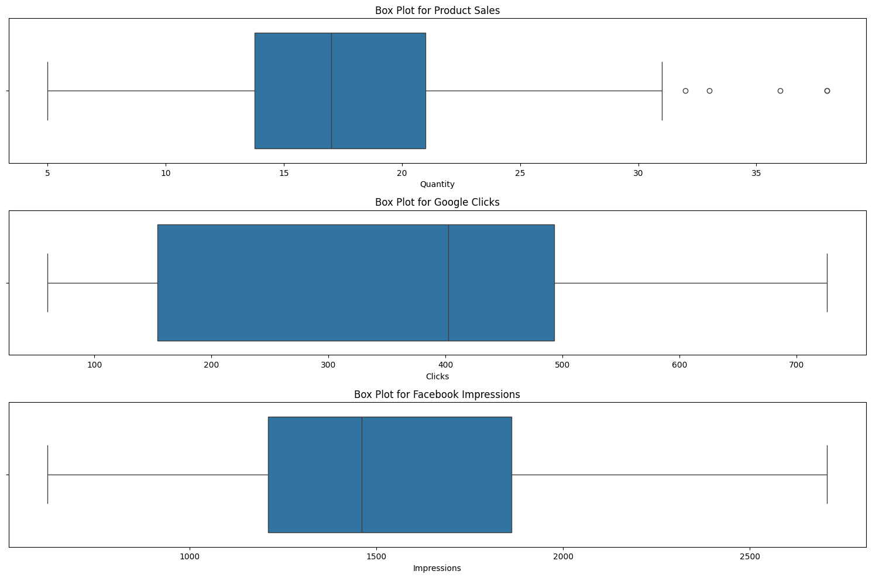
Data Overview
Outliers Detection:-
There are some outliers in Product Sale but not in Google Clicks and Facebook Impressions
Missing Values:-
There are no Missing values in all three datasets

Slide 6
Feature Engineering
Day Index | Quantity | Clicks | Impressions | Month | Day | Quarter | Year
2021-12-01 | 14 | 445 | 620 | 12 | 2 | 4 | 2021
2021-12-02 | 10 | 433 | 890 | 12 | 3 | 4 | 2021
2021-12-03 | 13 | 424 | 851 | 12 | 4 | 4 | 2021
2021-12-04 | 22 | 427 | 881 | 12 | 5 | 4 | 2021
2021-12-05 | 17 | 451 | 678 | 12 | 6 | 4 | 2021
Introduced New Features like Month, Day ,Quarter, Year which is not in Provided Dataset

Slide 7
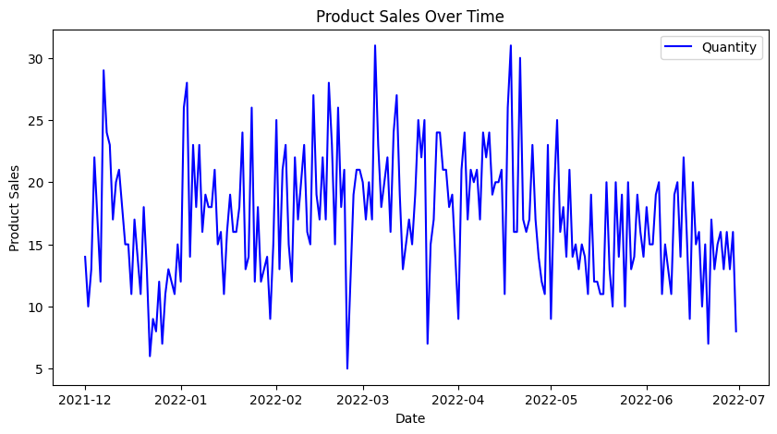
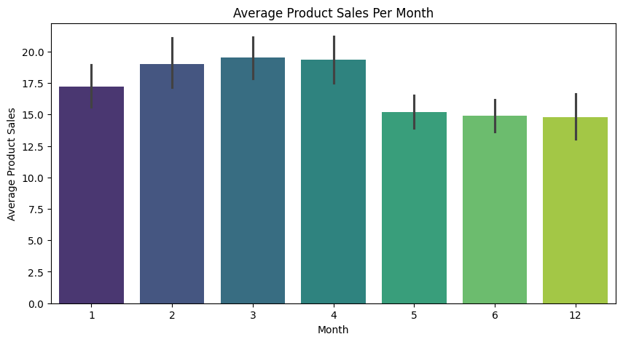
Visualization
The Highest sale is recorded in the March 2022 followed by April 2022
Average Product sale is higher in March followed by April & February

Slide 8
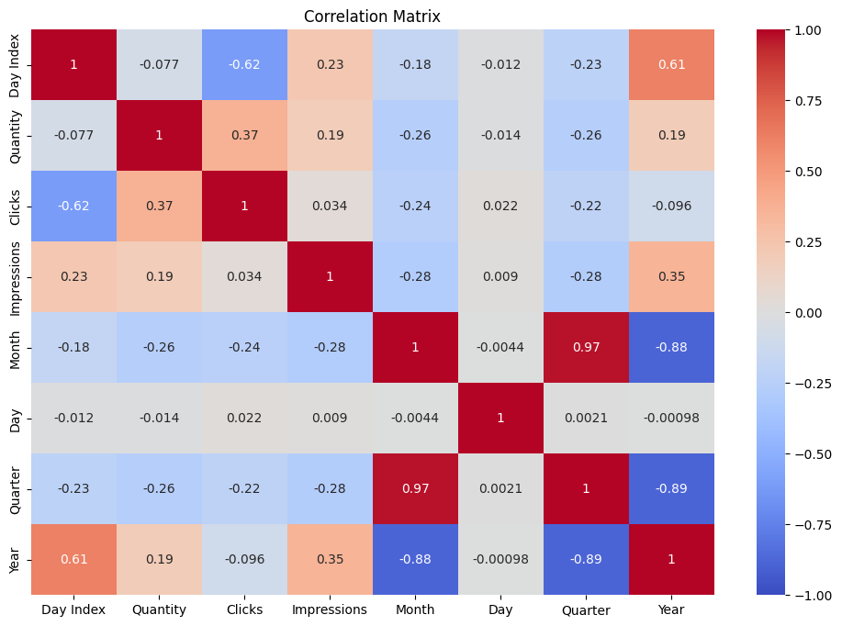
Correlation Matrix
Clicks are Positively correlated with sales as compared to impressions

Slide 9
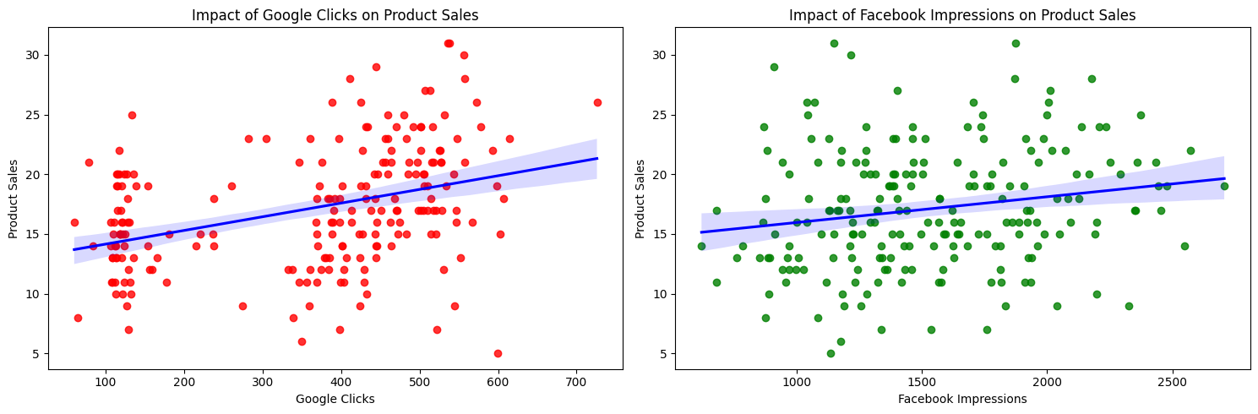
Impact of Clicks and Impressions
It shows the Positive Relationship between clicks and sale as well as
between impressions and sales

Slide 10
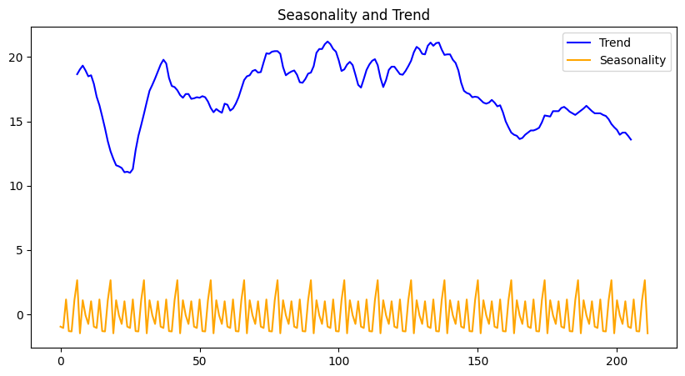
Time Series Analysis
ADF Test:-
ADF Statistic: -5.561
p-value: 1.53e-06
This indicates that the time series data for 'Quantity' is stationary, meaning it does not have a unit root and its statistical properties remain constant over time.
Seasonality and Trend Analysis
Seasonality:
Consistent fluctuations with regular intervals.
Peaks and troughs indicating recurring cycles.
Trend:
Noticeable long-term patterns with fluctuations.
General direction over time showing growth or decline.

Slide 11
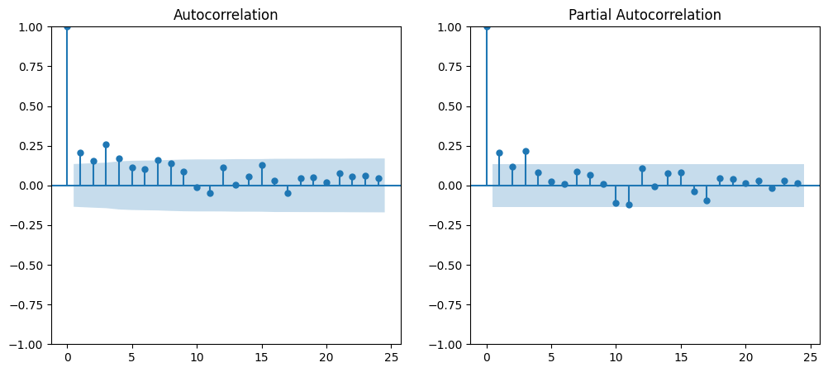
ACF and PACF Analysis
Autocorrelation (ACF):
Significant autocorrelation at lag 1.
Gradual decrease in correlation at higher lags.
Impact:
Indicates short-term dependency; useful for forecasting models like ARIMA.
Partial Autocorrelation (PACF):
Significant spikes at lag 1 and 2.
No significant spikes beyond lag 2.
Impact:
Suggests a short memory process; first two lagged values are key for modeling.

Slide 12
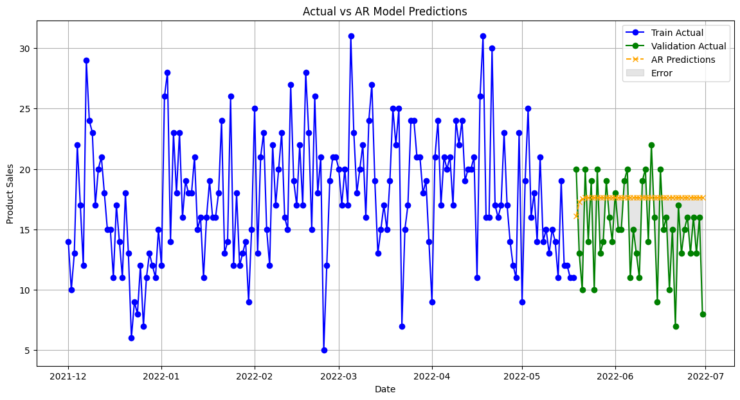

AR MODEL
MA MODEL
Metric | Values
RMSE | 4.44
MAE | 3.70
MAPE | 30.98
R^2 | 0.50
Adjusted R^2 | -0.53
Metric | Values
RMSE | 4.43
MAE | 3.69
MAPE | 30.91
R^2 | -0.49
Adjusted R^2 | -0.53

Slide 13
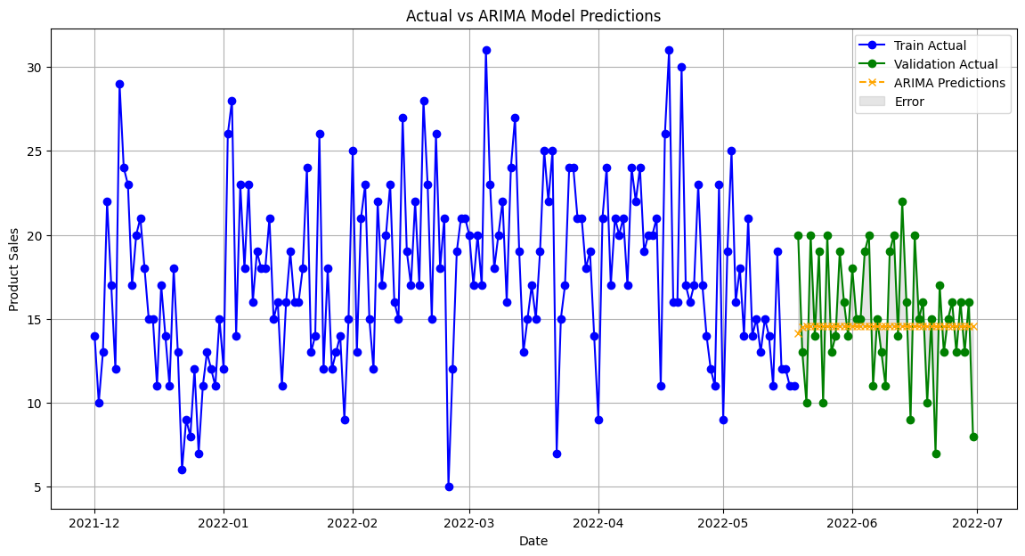
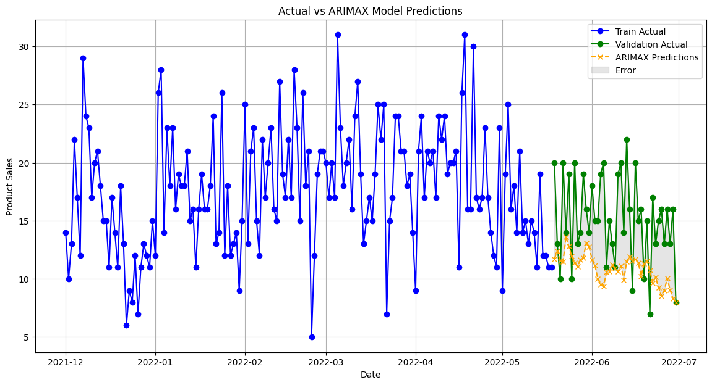
ARIMA MODEL
ARIMAX MODEL
Metric | Values
RMSE | 3.68
MAE | 2.96
MAPE | 21.82
R^2 | -0.03
Adjusted R^2 | -0.05
Metric | Values
RMSE | 5.61
MAE | 4.72
MAPE | 29.07
R^2 | -1.39
Adjusted R^2 | -1.87

Slide 14
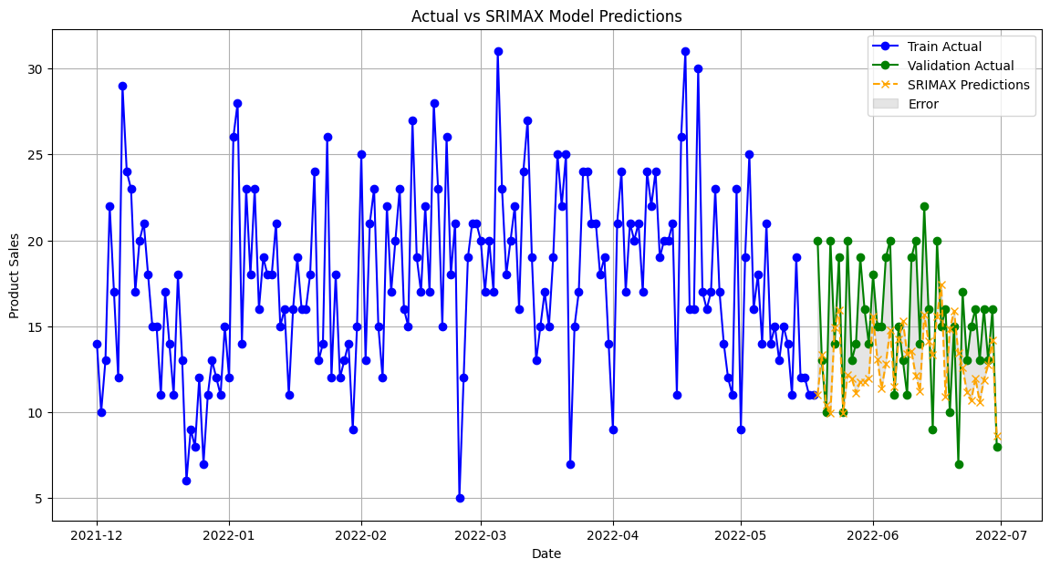
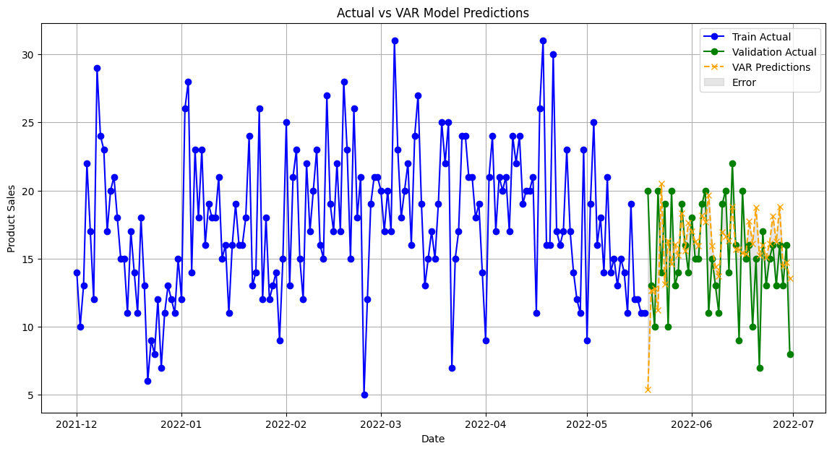
SRIMAX MODEL
Multivariate Model
Metric | Values
RMSE | 4.31
MAE | 3.50
MAPE | 22.83
R^2 | -0.41
Adjusted R^2 | -0.69
Metric | Values
RMSE | 4.44
MAE | 3.32
MAPE | 25.24
R^2 | -0.50
Adjusted R^2 | -0.80

Slide 15
Comparison of All Models
Model | RMSE | MAE | MAPE | R² | Adjusted R²
AR | 4.44 | 3.70 | 30.98 | -0.50 | -0.53
MA | 4.43 | 3.69 | 30.91 | -0.49 | -0.53
ARIMA | 3.68 | 2.96 | 21.82 | -0.03 | -0.05
ARIMAX | 5.61 | 4.72 | 29.07 | -1.39 | -1.87
SRIMAX | 4.31 | 3.50 | 22.83 | -0.41 | -0.69
Multivariate | 5.61 | 4.72 | 29.07 | -1.39 | -1.87

Slide 16
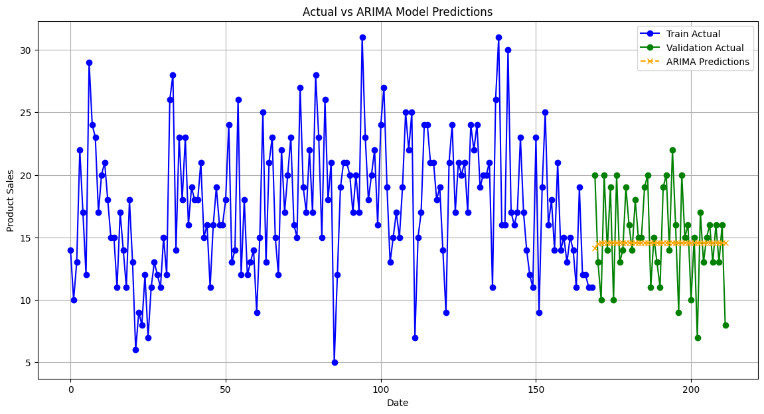
Conclusion
Best Performing Model:
The ARIMA Model shows the lowest RMSE (3.68) and MAE (2.96 ), indicating it has the best overall performance in terms of accuracy.
It also has a relatively low MAPE (21.82), meaning it predicts the percentage errors better compared to other models.

